Slide 1
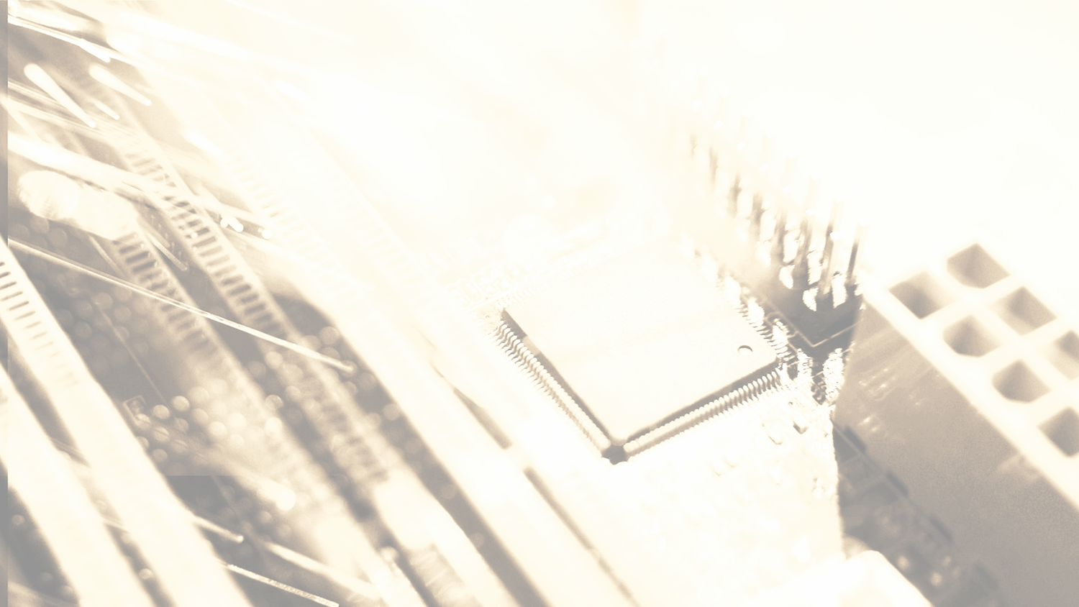
COMPUTER NETWORK
CHINESE NAME: 歐跟莎
STUDENT ID: 4110E206
MY DEAR GREAT TEACHER

Slide 2
AGENDA
Computer Network
WAN,MAN,LAN,PAN
Hardware
Network Connecting Device
Network Topology
Software
OSI MODEL
TCP/IP Protocal
Windows Networking Commands

Slide 3

COMPUTER NETWORK

Slide 4
01
WHAT IS A COMPUTER NETWORK?
MY DEAR GREAT TEACHER

Slide 5
COMPUTER NETWORK
Computer networking refers to the interconnection of computing devices that can exchange data and share resources. These networked devices use a set of rules known as communications protocols to transmit data over physical or wireless networks.

Slide 6
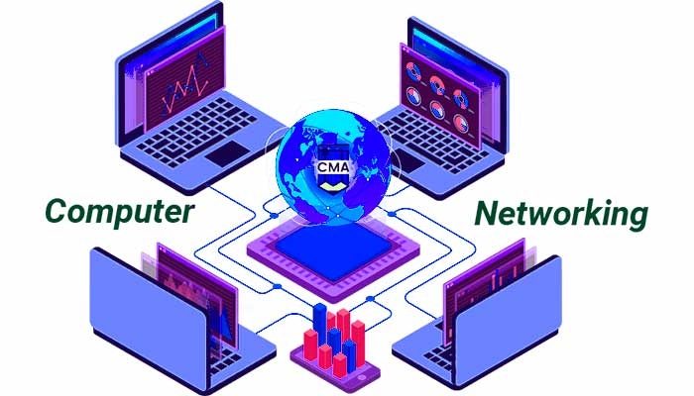

Slide 7
COMPUTER NETWORK TYPES BY SCALE

Slide 8
02
WHAT IS A WAN? WIDE-AREA NETWORK
MY DEAR GREAT TEACHER

Slide 9
WIDE-AREA NETWORK
A wide area network (WAN) is a private telecommunications network that connects multiple local area networks geographically (LANs). A local area network (LAN) is a collection of computers and network devices that are all linked to each other, typically from within a short relative geographical distance. A WAN may include connections to a company's headquarters, branch offices, colocation facilities, cloud services, and other facilities in an enterprise or business. A router or other multifunction device is typically used to connect a LAN to a WAN. Users of enterprise WANs can share access to applications, services, and other centrally located resources.

Slide 10
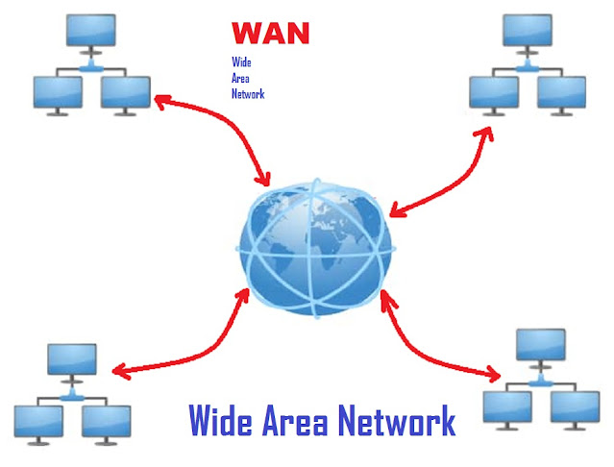

Slide 11
03
WHAT IS A MAN? METROPOLITAN AREA NETWORK
MY DEAR GREAT TEACHER

Slide 12
METROPOLITAN AREA NETWORK
A Metropolitan Area Network is a computer network that connects users to computer resources in a metropolitan area. The term MAN refers to the consolidation of several local area networks (LANs) in a city into a single, more extensive network that can efficiently connect to a wide area network. The term is also used to describe the use of point-to-point connections to connect many local area networks in a metropolitan region.

Slide 13
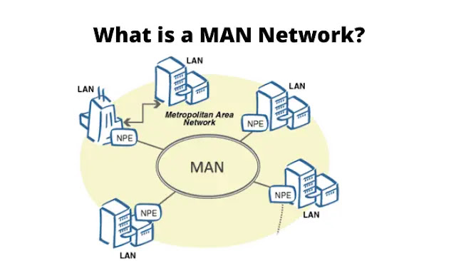

Slide 14
04
WHAT IS A LAN? LOCAL AREA NETWORK
MY DEAR GREAT TEACHER

Slide 15
LOCAL AREA NETWORK
A local area network (LAN) is a group of devices that are connected in a single physical location, such as a building, office, or home. A LAN can be small or large, ranging from a home network with one user to an enterprise network in an office or school with thousands of users and devices.

Slide 16
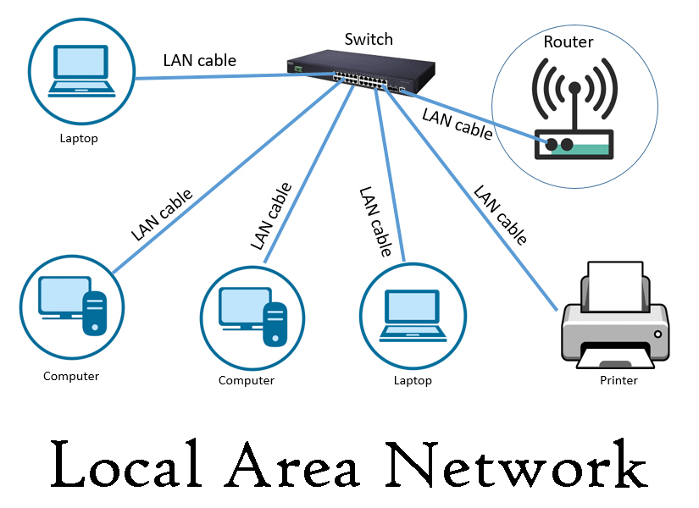

Slide 17
05
WHAT IS A PAN? PERSONAL AREA NETWORK
MY DEAR GREAT TEACHER

Slide 18
PERSONAL AREA NETWORK
A personal area network (PAN) is a computer network that connects computers/devices in one's immediate vicinity. PAN stands for Personal Area Network because it provides a network range that is frequently within 10 meters (33 feet) of a person. A Personal Area Network (PAN) typically includes a computer, printer, mobile phone, tablet, Personal Digital Assistant (PDA), and other entertainment devices such as video game consoles, TV remotes, wearable gadgets, speakers, and so on.

Slide 19
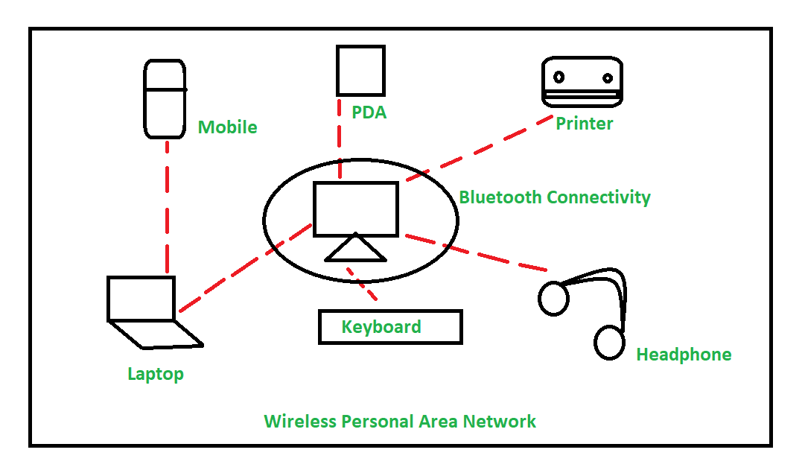

Slide 20
06
WHAT IS A CAN? CONTROLLER AREA NETWORK
MY DEAR GREAT TEACHER

Slide 21
CONTROLLER AREA NETWORK
A Controller Area Network (CAN) bus is a communication system designed for vehicle intercommunication. This bus enables many microcontrollers and different types of devices to communicate with one another in real time and without the need for a host computer.

Slide 22
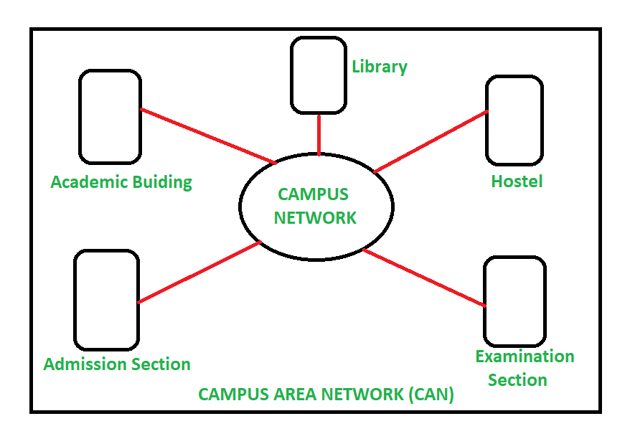

Slide 23
07
WHAT IS A BAN? BODY AREA NETWORK
MY DEAR GREAT TEACHER

Slide 24
BODY AREA NETWORK
A body area network (BAN) is a wireless network of wearable computing devices. It is also known as a wireless body area network (WBAN), a body sensor network (BSN), or a medical body area network (MBAN). BAN devices can be implanted inside the body, surface-mounted on the body in a fixed position, or accompanied devices that humans can carry in various positions, such as clothing pockets, by hand, or in various bags.

Slide 25
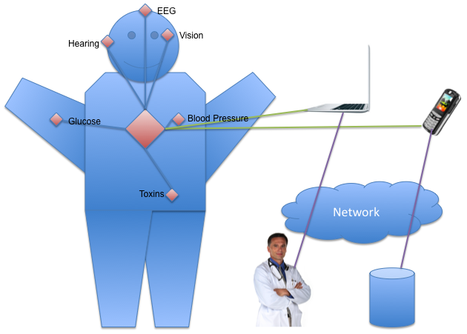

Slide 26
NETWORK DEVICES AND HARDWARE
REPEATER
L3- SWITCH
HUB
L4- SWITCH
BRIDGE
L7- SWITCH
SWITCH
PROXY
ROUTER
ETC.

Slide 27
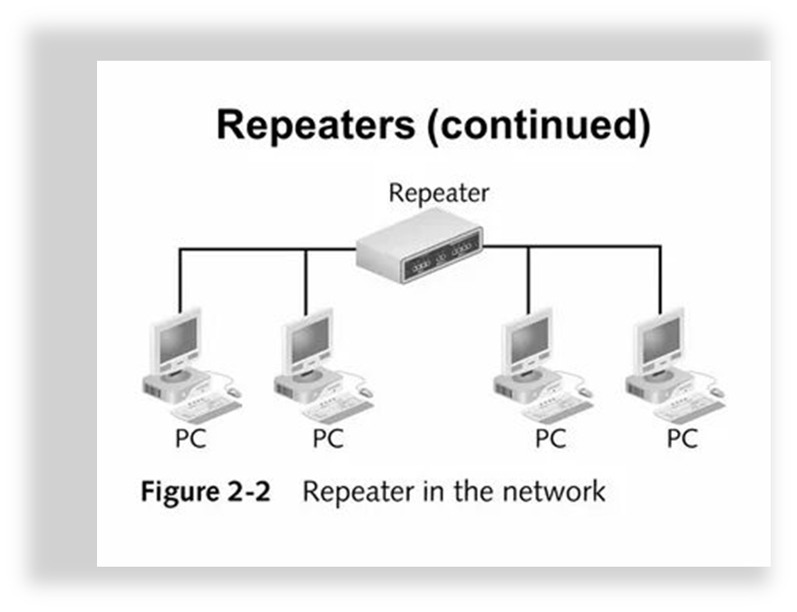
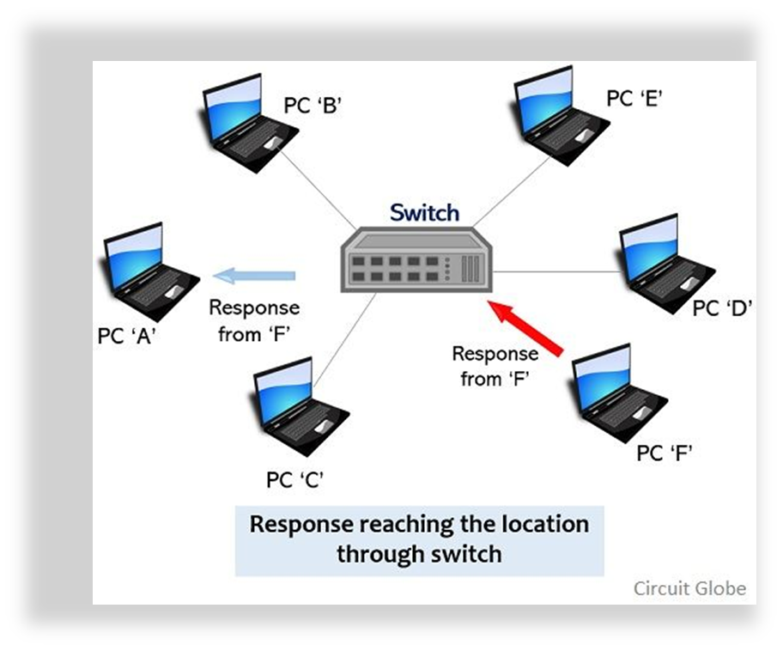
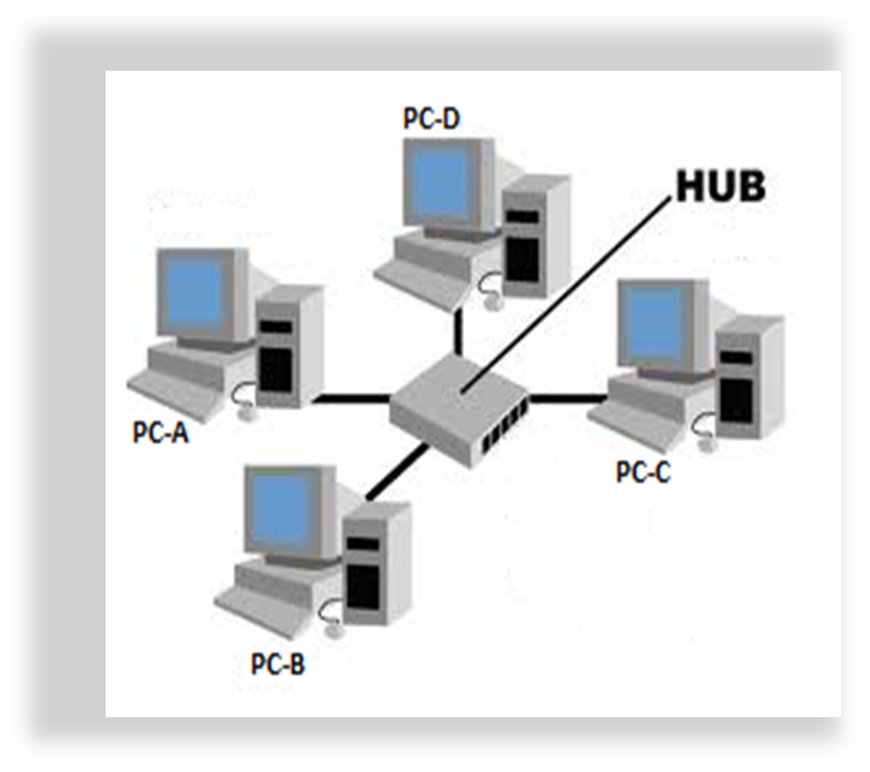
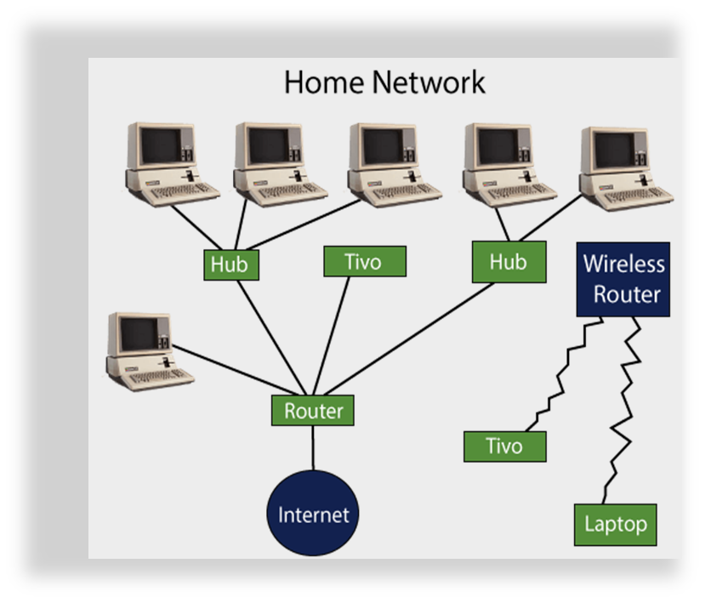
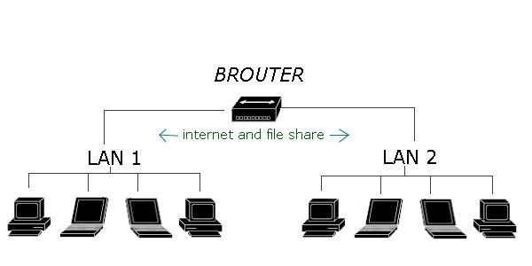
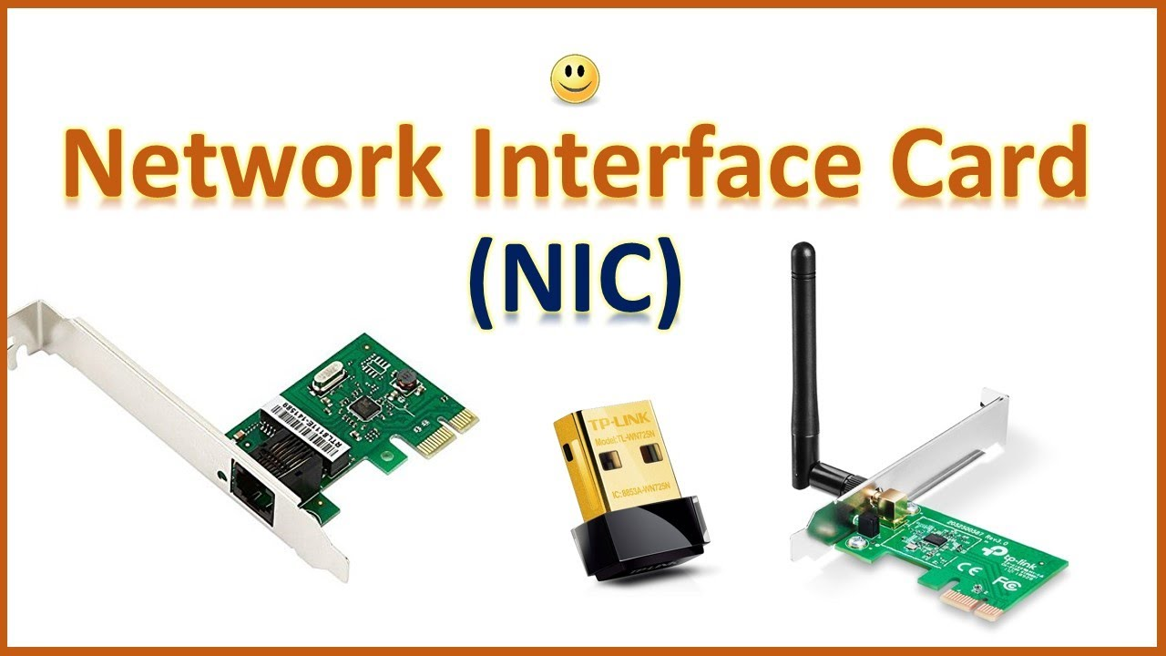
NETWORK CONNECTING DEVICES
THIS PICTURE IS ALL THE NETWORK
CONNECTING DEVICES

Slide 28


REPEATER
Repeaters are used in computer networks to increase network coverage, replicate a weak or broken signal, and/or service remote nodes. Repeaters amplify the received/input signal to a higher frequency domain, allowing it to be reused, scalable, and available.

Slide 29
HUB
A network hub is a node that broadcasts data to all computers and Ethernet-connected devices that are connected to it. A hub lacks the sophistication of a switch, which can isolate data transmissions to specific devices.

Slide 30
TYPES OF HUB:
Active Hub: These are hubs with their own power sources that can also amplify, clean, and relay the network's signal. It functions as a wiring center and a repeater at the same time. The maximum distance between nodes can be increased using these.
The hubs known as "passive hubs" are those that receive power and wiring from active hubs. These hubs cannot be utilized to increase the distance between nodes because they just transport signals onto the network without boosting or cleaning them.
Integrated Hub: It functions as an active hub and has the ability for remote management. They also provide network devices adjustable data rates. Additionally, it permits an administrator to set up each port and watch the traffic going through the hub.
.

Slide 31
SWITCH
A network switch is a device that forwards data packets between devices. Switches send packets directly to devices rather than to networks, as routers do.

Slide 32
ROUTER
A router connects two or more packet-switched networks or subnetworks. Its primary functions are to manage traffic between these networks by forwarding data packets to their intended IP addresses and to allow multiple devices to use the same Internet connection.

Slide 33
GATEWAY
A computer that serves as a bridge between different networks or applications. The gateway is responsible for converting information, data, or other communications from one protocol or format to another. Some gateway functions may be performed by a router. An Internet gateway is a device that connects an enterprise network to the Internet.

Slide 34
BROUTER
A bridge router, also known as a brouter, is a network device that serves as both a bridge and a router. The brouter simply forwards all other packets and routes packets for known protocols as a bridge would. Brouters work at both the network and data link layers for routable protocols and at the network and data link layers for non-routable protocols..

Slide 35
NIC
A network interface card (NIC) is a piece of hardware, usually a circuit board or chip, that is installed on a computer to allow it to connect to a network.

Slide 36
ACCESS POINT
An access point is a device that creates a wireless local area network, or WLAN, in a building or office. An access point uses an Ethernet cable to connect to a wired router, switch, or hub and broadcasts a WiFi signal to a specific area.

Slide 37
RANGE EXTENDER
A range extender, as the name implies, extends the reach of an existing WiFi network. Because range extenders connect wirelessly to WiFi routers, they must be placed where the WiFi router's signal is already strong, rather than in the dead spot itself. For example, if your router is located in the basement of a two-story building, installing a range extender on the ground floor (where WiFi router coverage is still strong) will eliminate potential dead zones on the second floor.

Slide 38



HARDWARE
L1 DEVICES: REPEATER VS HUB
Although repeaters and hubs are now essentially the same thing, this was not always the case. The repeater's primary goal, as implied by the name, is to "repeat." Because of the nature of electrical current, the signal would eventually fade over time and become unintelligible. Repeaters take an incoming signal that is losing strength and "juice" it to make it travel further. In essence, this could be accomplished with a hub, but the main difference is in the device's design. On the repeater, both the incoming signal port and the "boosted" outgoing signal port are present.

Slide 39
HARDWARE
L2 DEVICES: BRIDGE VS SWITCH
Both operate at the Data Link layer (Layer 2), which also houses bridges and switches. Both can filter data so that only the appropriate segment or host receives transmissions. While modern switches occasionally have the features of a router and can pass data based on IP address (working at the Network Layer), they are referred to as IP Switches and both filter packets based on the physical address (AKA MAC - Media Access Control - address) of the sender/receiver. Both switches and bridges can frequently produce the required effects, though switches are typically used for their filtering capabilities to build many, smaller virtual networks, whereas bridges are used to increase the network's range while reducing overall traffic, and switches are primarily used for their filtering ability. to divide a single physical LAN into several smaller virtual LANs (VLANs) for easier management and administration. Switch technology, on the other hand, is thought to be superior to bridge technology.

Slide 40
HARDWARE
LAYER 4
The Transport Layer, or Layer 4 of the OSI Model, provides dependable data transmission services to the upper layers by facilitating transparent data flow between end users. The transport layer manages the dependability of a specific link via flow control, segmentation and Desegmentation, and error management. Some protocols concentrate on connections and states. This means that the transport layer can monitor the segments and resend any that fail. Furthermore, the transport layer provides confirmation of successful data transmission and, in the absence of any errors, delivers the subsequent data. Layer 4 protocols include Transmission Control Protocol (TCP) and User Datagram Protocol (UDP) (UDP).

Slide 41
HARDWARE
LAYER 7 DEVICES: PROXY
The L7 service network assists in traffic allocation at the application layer. TCP and UDP are components of the transport layer, or L4 service network. A layer 7 load balancer decides where to send traffic based on IP addresses, TCP or UDP ports, or any other information gleaned from the application protocol (mainly HTTP). As a proxy, the layer 7 load balancer maintains two TCP connections open—one with the client and one with the server. After the packets have been reassembled, the load balancer can decide where to direct traffic based on information obtained from application requests or responses. While it may appear that this type of processing takes a long time, it only takes a millisecond or so.

Slide 42
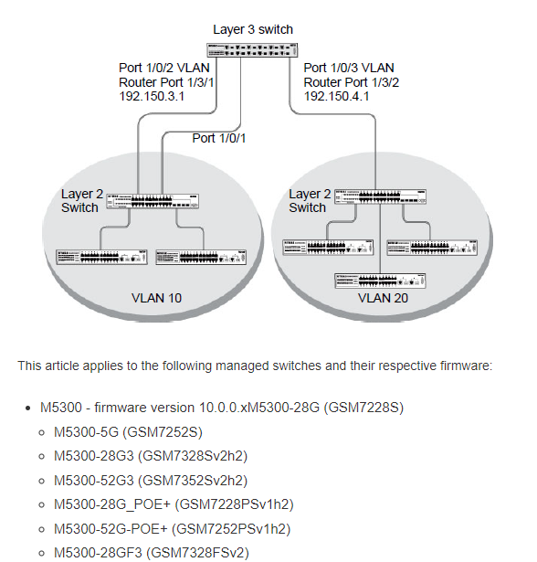
SWITCH (VLAN)

Slide 43
08
WHAT IS A VLAN? VIRTUAL LOCAL AREA NETWORK
MY DEAR GREAT TEACHER

Slide 44
VIRTUAL LOCAL AREA NETWORK
A VLAN is a customized network that is built from one or more local area networks. It allows a group of devices from multiple networks to be combined into a single logical network. As a result, a virtual LAN is created that can be managed similarly to a physical LAN. VLAN stands for Virtual Local Area Network.

Slide 45
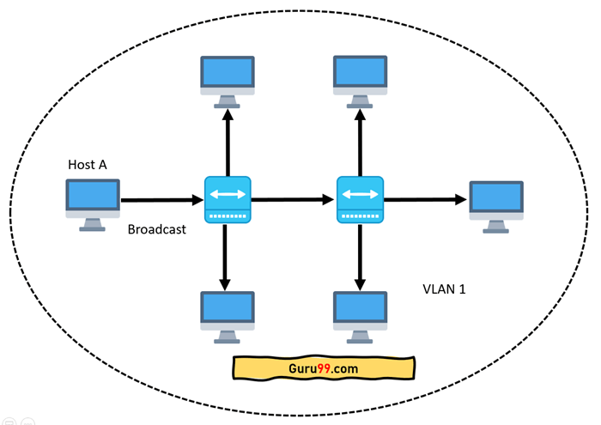

Slide 46
NETWORK TOPOLOGY
A network topology is the physical and logical configuration of a network's nodes and connections. Nodes typically include switches, routers, and software with switch and router capabilities. Graphs are frequently used to represent network topologies.

Slide 47
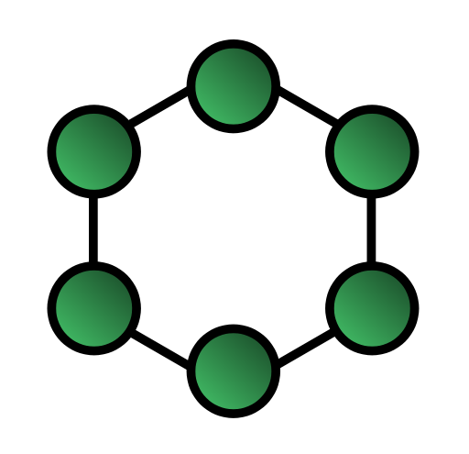
RING
A ring topology is a daisy chain in a closed loop. Data flows in a single direction around the ring. When one node sends data to another, it travels around the ring's intermediate nodes until it arrives at its final destination. To keep the signal strong, the intermediary nodes repeat (retransmit) the data. There is no distinction between clients and servers; each node is considered a peer. If a node on the bus is unable to send data again, communication with the nodes before and after it is broken.

Slide 48
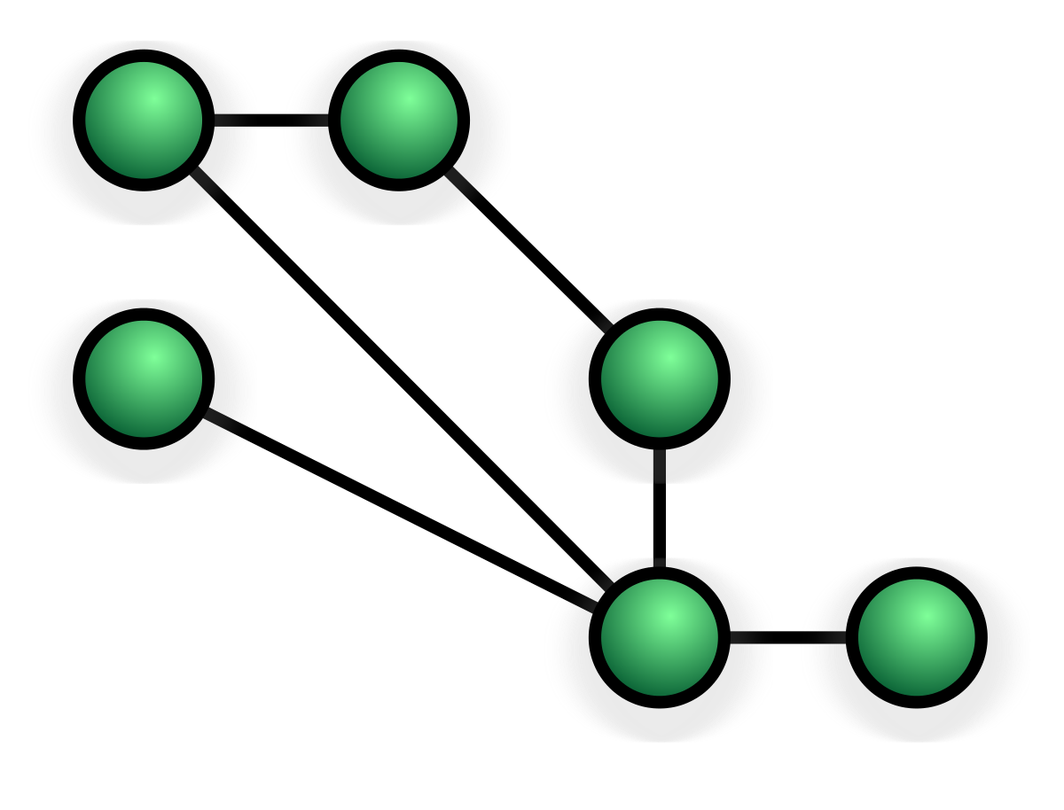
MESH
A ring topology is a daisy chain in a closed loop. Data flows in a single direction around the ring. When one node sends data to another, it travels around the ring's intermediate nodes until it arrives at its final destination. To keep the signal strong, the intermediary nodes repeat (retransmit) the data. There is no distinction between clients and servers; each node is considered a peer. If a node on the bus is unable to send data again, communication with the nodes before and after it is broken.

Slide 49

STAR
A star topology, also known as a star network, is a network topology that connects each device to a central hub. It is by far the most common Network Topology and one of the most common computer network configurations. In this network configuration, all devices connected to a central network device are represented by a star.

Slide 50
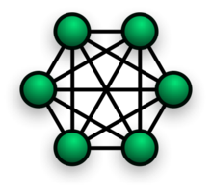
FULLY CONNECTED
A fully connected layer is a neural network in which each neuron uses a weights matrix to apply a linear transformation to the input vector. As a result, all possible layer-to-layer connections are present, which means that every input of the input vector influences every output of the output vector.

Slide 51

LINE
A bus topology known as the line topology connects each node to the host computer in a straight line. The information is transferred from one node to another via a bus that connects the nodes via cables. Bus topology, also known as backbone topology or line topology, arranges devices along a single cable that connects one end of the network to the other. The wire will carry data as it travels to its final destination. PROS: Economically viable for smaller networks.

Slide 52
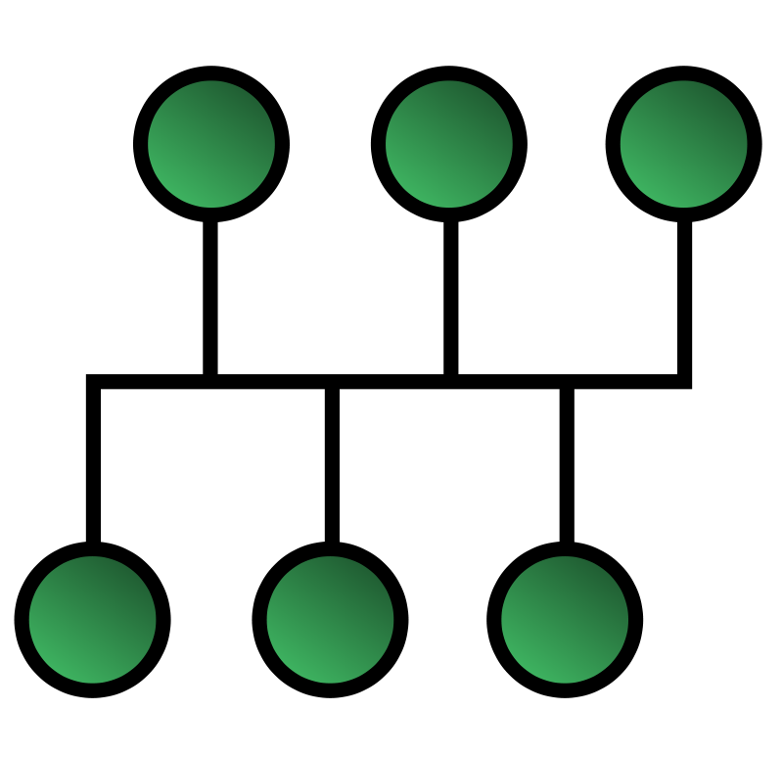
BUS
A bus network is a LAN topology in which each node (a workstation or other device) is connected to a main cable or link known as a bus. All bus-connected stations can communicate with all other stations on the same network segment. A bus network topology is straightforward and dependable.

Slide 53
INTERNET
The Internet, also known as “The Net," is a worldwide network of computer networks
- a network of networks in which users at any one computer can obtain information from any other computer if they have permission (and sometimes talk directly to users at other computers).

Slide 54
TYPES OF NETWORKS
POINT TO POINT NETWORKS
MULTIPOINT
BROADCAST NETWORKS
P2P NETWORKS
CLIENT SERVER NETWORKS
HYBRID NETWORKS

Slide 55
POINT TO POINT NETWORKS
Point to Point networking is a type of data networking that creates a direct connection between two networking nodes. A point to point connection is a direct link between two devices, such as a computer and a printer.

Slide 56
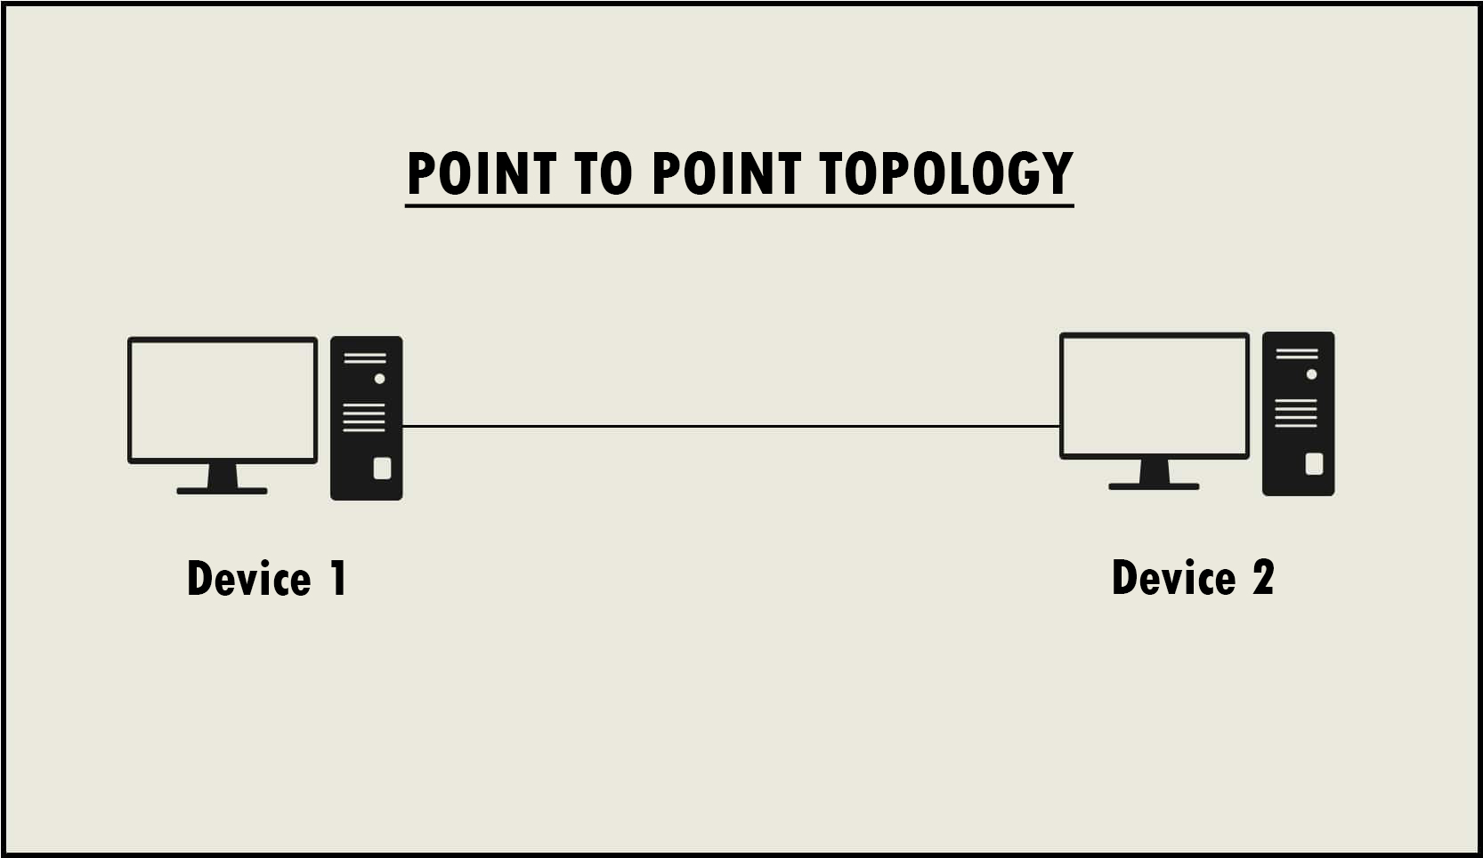

Slide 57
MULTIPOINT NETWORKS
is one in which more than two specific devices share links. The capacity of the channel is shared in the multipoint environment, either spatially or temporally. A spatially shared connection is one that can be used by multiple devices at the same time.

Slide 58
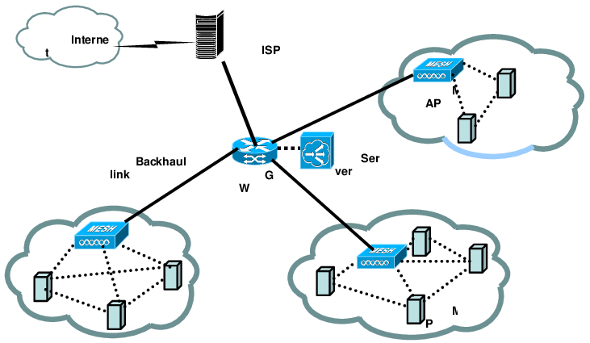

Slide 59
BROADCAST NETWORKS
A signal method in broadcast networks in which multiple parties can hear a single sender. Radio stations are an excellent example of the "Broadcast Network" in everyday life. In this scenario, the radio station is a sender of data/signal, and data is only intended to travel in one direction. To be specific, away from the radio transmission tower.

Slide 60
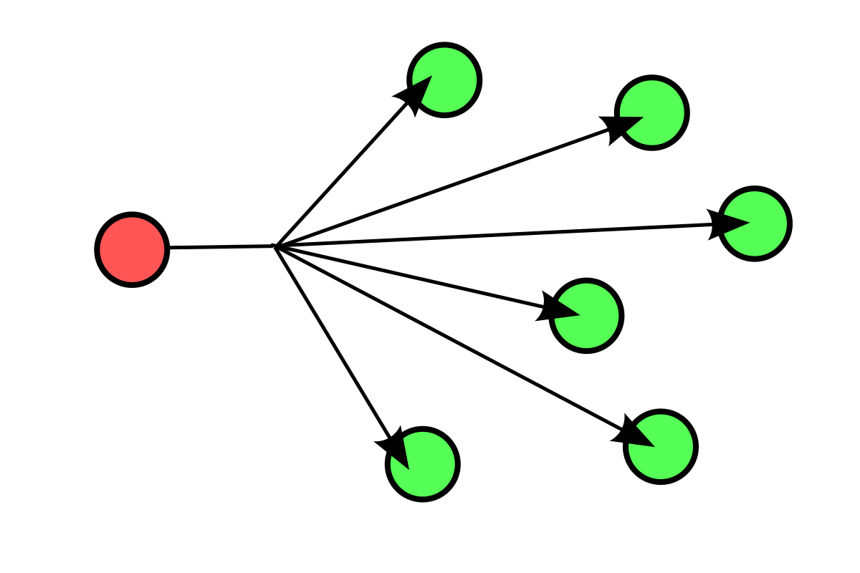
BROADCAST NETWORKS

Slide 61
P2P NETWORKS
Peers are computers with similar capabilities and configurations. "Peer to Peer" is an abbreviation for "peer to peer." A peer-to-peer network's "peers" are computer systems that communicate with one another via the Internet. Files can be shared directly between network systems without the use of a centralized server.

Slide 62
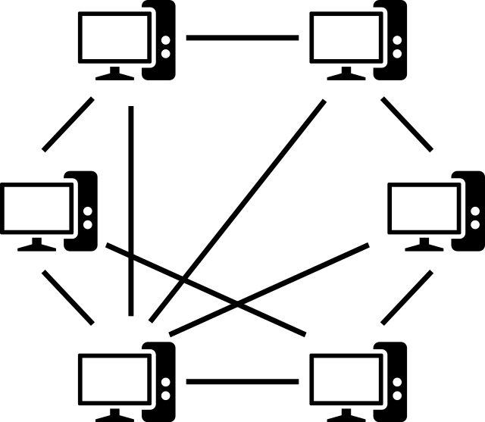
P2P NETWORKS

Slide 63
CLIENT SERVER NETWORKS
In a client-server architecture (client/server), every computer or process on the network is either a client or a server. The client requests services from the server, which the server fulfills. Servers are high-performance computers or processes that manage disc drives (file servers), printers (print servers), or network traffic (network servers)

Slide 64

CLIENT SERVER NETWORKS

Slide 65
HYBRID NETWORKS
A hybrid topology is a network topology that combines two or more different network topologies. These topologies can be a combination of bus topology, mesh topology, ring topology, star topology, and tree topology.

Slide 66
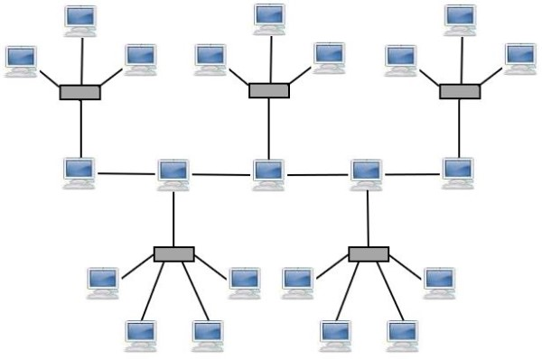

Slide 67
DAISY CHAIN
Daisy chaining is accomplished by connecting each computer in series to the next. If a message is intended for a computer further down the line, each system forwards it in sequence until it reaches its destination. A daisy-chained network can be classified into two types: linear and ring. A linear topology establishes a two-way link between two computers. However, this was costly in the early days of computing because each computer (except those at each end) required two receivers and two transmitters.

Slide 68
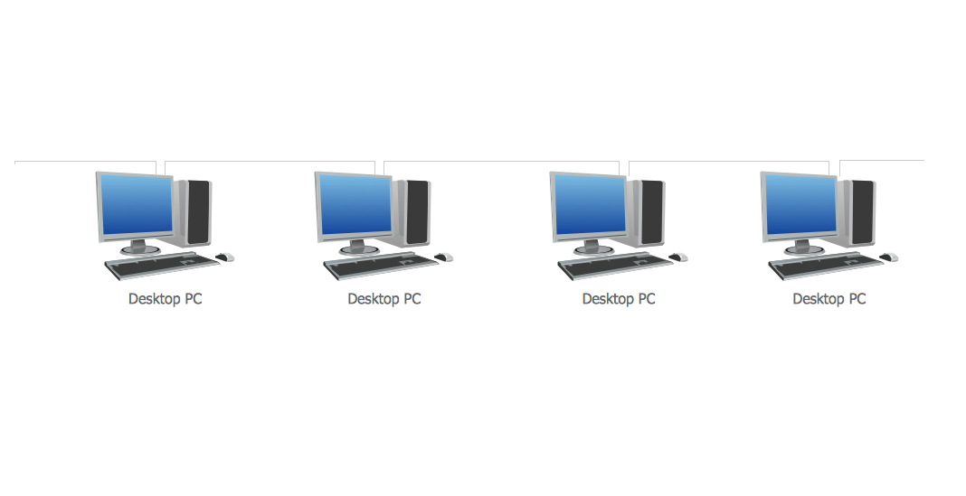

Slide 69
NETWORK TOPOLOGY
A network topology is the physical and logical arrangement of nodes and connections in a network. Nodes typically include devices such as switches, routers, and software with switch and router capabilities. Network topologies are frequently represented as graphs.

Slide 70
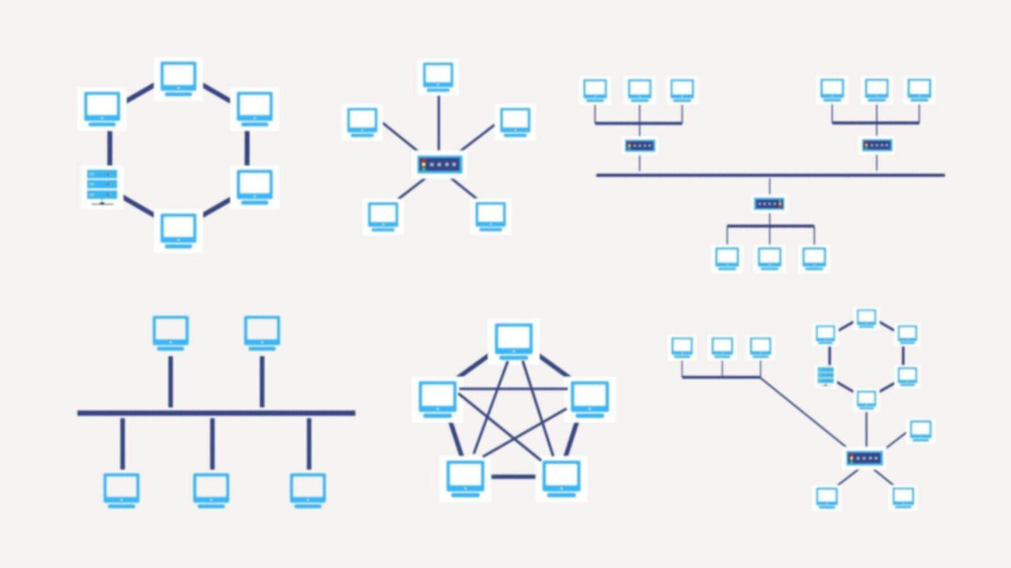

Slide 71
TWO BASIC CATEGORIES OF NETWORK TOPOLOGIES
MY DEAR GREAT TEACHER

Slide 72
PHYSICAL TOPOLOGIES
The physical topology of the network is defined by the transmission medium layout used to connect devices. This refers to the layout of cabling, the locations of nodes, and the links between the nodes and the cabling for conductive or fiber optical mediums. The physical topology of a network is determined by the capabilities of network access devices and media, the level of control or fault tolerance desired, and the cost of cabling or telecommunication circuits.

Slide 73
LOGICAL TOPOLOGIES
A logical topology is a networking concept that defines the architecture of the communication mechanism for all nodes in a network. A network's logical topology can be dynamically maintained and reconfigured using network equipment such as routers and switches.

Slide 74
CPU CENTRAL PROCESSING UNIT
The central processing unit (CPU) is the main component of any digital computer system, consisting of the main memory, control unit, and arithmetic-logic unit. It is the physical heart of the entire computer system, to which various peripheral equipment, such as input/output devices and auxiliary storage units, are connected. The CPU in modern computers is housed on an integrated circuit chip known as a microprocessor.

Slide 75
GPU GRAPICS PROCESSING UNIT
The graphics processing unit, or GPU, has emerged as one of the most important types of computing technology, both for personal and business use. The GPU, which was designed for parallel processing, is used in a variety of applications, including graphics and video rendering. Although they are best known for their gaming capabilities, GPUs are becoming more popular for use in creative production and artificial intelligence (AI).

Slide 76
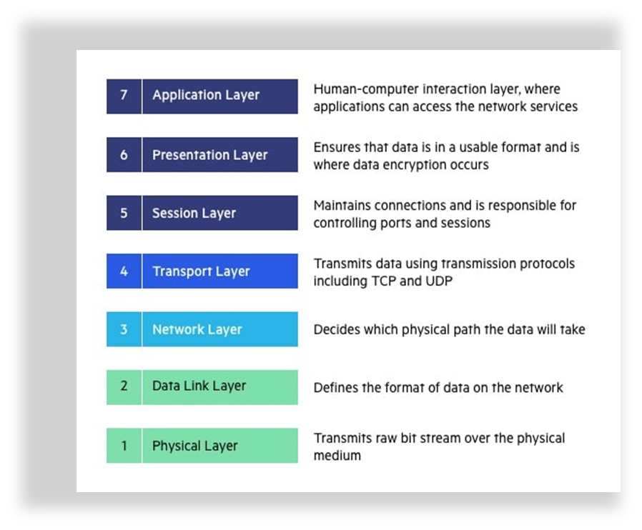
OSI MODEL

Slide 77
OSI OPERATION SYSTEM INTERCONNECTION
The Open Systems Interconnection (OSI) model defines seven layers through which computer systems communicate over a network. It was the first standard model for network communications, and it was adopted in the early 1980s by all major computer and telecommunications companies.

Slide 78
IP INTERNET PROTOCOL
IP - Internet Protocol is in charge of delivering packets from the source host to the destination host by examining the IP addresses in the packet headers. IP comes in two flavors: IPv4 and IPv6. The majority of websites are currently using IPv4. However, IPv6 adoption is increasing because the number of IPv4 addresses is limited in comparison to the number of users.

Slide 79
TCP TRANSMISSION CONTROL PROTOCOL
Transmission Control Protocol (TCP) - It is known to provide reliable and error-free communication between end systems. It sequences and segments data. It also has an acknowledgement feature and controls data flow via a flow control mechanism. It is a very effective protocol, but it has a lot of overhead because of these features. Increased overhead leads to increased costs.

Slide 80
UDP USER DATAGRAM PROTOCOL
User Datagram Protocol (UDP) - On the other hand, it lacks such features. Because it is very cost-effective, it is the preferred protocol if your application does not require reliable transport. In contrast to TCP, which is a connection-oriented protocol, UDP is a connectionless protocol.

Slide 81
IPS INTERNET PROTOCOL SUITE
IPS- TCP/IP, or the Internet protocol suite, is a framework for organizing the set of communication protocols used in the Internet and similar computer networks based on functional criteria.

Slide 82
HTTP
HYPER TEXT TRANSFER PROTOCOL
The Hypertext Transfer Protocol (HTTP), which is used to load webpages via hypertext links, is the foundation of the World Wide Web. HTTP is an application layer protocol that runs on top of other layers of the network protocol stack to transfer data between networked devices. A typical HTTP flow starts with a client machine sending a request to a server, which then sends a response message.

Slide 83
HTTPS
HYPER TEXT TRANSFER PROTOCOL SECURE
The secure version of HTTPS - Hypertext Transfer Protocol Secure, which is the primary protocol used to send data between a web browser and a website, is known as HTTPS. HTTPS is encrypted to increase data transfer security. This is especially important when users send sensitive data, such as when they log into a bank account, email service, or health insurance provider.

Slide 84
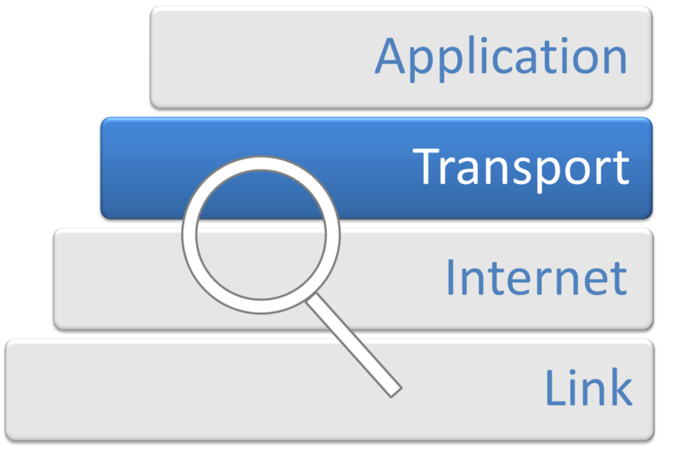
TRANSPORT LAYER
The transport layer in computer networking refers to a conceptual division of protocols in the network stack's tiered design, as defined by the OSI model and the Internet protocol suite. This layer's protocols provide end-to-end communication services to applications. It provides services such as dependability, flow control, multiplexing, and connection-oriented communication. The OSI model of general networking and the implementation specifics and semantics of the transport layer of the Internet protocol suite,[1] which serves as the Internet's backbone, are distinct. All of the protocols used in this layer of the Internet today have their origins in the development of TCP/IP. While numbered layers are not used in the OSI model, the transport layer is commonly referred to as Layer 4, or L4.

Slide 85
INTERCONNECTING LAYER
This layer aids in the encapsulation of data in packets known as IP datagrams. They have access to the source and destination IP addresses that are sent to hosts via the network. Additionally, they provide IP datagram routing with IP address markings. The interconnecting layer (ICL), which electrically connects two subcells in tandem OSCs, is critical for determining the device's performance and repeatability. We begin this review paper by providing a brief overview of the ICL specifications and operational mechanism.

Slide 86

SEVEN TYPES LAYER
PHYSICAL LAYER
DATA LINK LAYER
NETWORK LAYER
SESSION LAYER
TRANSPORT LAYER
PRESENTATION LAYER
APPLICATION LAYER
MY DEAR GREAT TEACHER

Slide 87
PL PHYSICAL LAYER
The Physical Layer is in charge of sending and receiving unstructured raw data between a device like a network interface controller, Ethernet hub, or network switch and a physical transmission medium. It is responsible for converting digital bits into electrical, radio, or optical signals. Layer specifications define voltage levels, voltage change timing, physical data rates, maximum transmission distances, modulation scheme, channel access method, and physical connectors. For wireless devices, this includes pin layout, voltages, line impedance, cable specifications, signal timing, and frequency. Bit rate control occurs at the physical layer, and transmission modes include simplex, half duplex, and full duplex. A network topology can be used to describe the components of a physical layer.

Slide 88
DLL DATA LINK LAYER
The data link layer enables node-to-node data transfer—a connection between two directly connected nodes. It detects and possibly corrects errors that may occur in the physical layer. It specifies the protocol for establishing and terminating a connection between two physically connected devices. It also defines the protocol for flow control between them..

Slide 89
ICL INTERCONNECTING LAYER
The interconnecting layer (ICL) electrically connects two subcells and is crucial to device performance and reproducibility. In this review paper, we first provide a brief overview of the working mechanism and ICL requirements.

Slide 90
SL SESSION LAYER
The session layer creates sessions, or communication channels, between devices. It is in charge of starting sessions, keeping them active and open while data is exchanged, and shutting them down once communication is complete. The session layer can also create checkpoints during a data transmission, allowing devices to resume where they left off if the session is terminated.

Slide 91
TL TRANSPORT LAYER
The transport layer divides data transferred in the session layer into "segments" at the receiving end. It is in charge of reassembling the segments on the receiving end in order to generate data that the session layer can use. The transport layer handles error control, which determines whether data was received incorrectly and, if so, requests it again, as well as flow control, which sends data at a rate that matches the receiving devices connection speed.

Slide 92
PL PRESENTATION LAYER
The presentation layer preps data for the application layer. It specifies how two devices should encode, encrypt, and compress data in order for data to be correctly received on the other end. Any data transmitted by the application layer is processed by the presentation layer before being delivered via the session layer.

Slide 93
AL APPLICATION LAYER
End-user applications, such as web browsers and email clients, operate at the application layer. It provides protocols that allow computer programs to send and receive data while also providing consumers with useful information. Application layer protocols include HTTP, FTP, POP, SMTP, and DNS (DNS).

Slide 94
2 TYPES OF NETWORK COMMANDS
WINDOWS NETWORKING COMMANDS
LINUX NETWORKING COMMANDS
MY DEAR GREAT TEACHER

Slide 95
NETWORK COMMANDS
As previously discussed, networking commands are used at the command prompt to obtain network information such as the system's IP address (remember, an IP address is the address of your device in a network), MAC address, network route traversed by a packet, and the IP address of the server on which a website or URL is hosted.

Slide 96
WNC WINDOWS NETWORKINGS COMMANDS
The network command in Windows allows you to create network domains. A domain is a collection of linked Windows computers that share user account information as well as a security policy. A domain controller is in charge of all domain members' user account information.

Slide 97
LNC LINUX NETWORKINGS COMMANDS
Linux networking commands are widely used to inspect, analyze, maintain, and troubleshoot the system's networks.

Slide 98
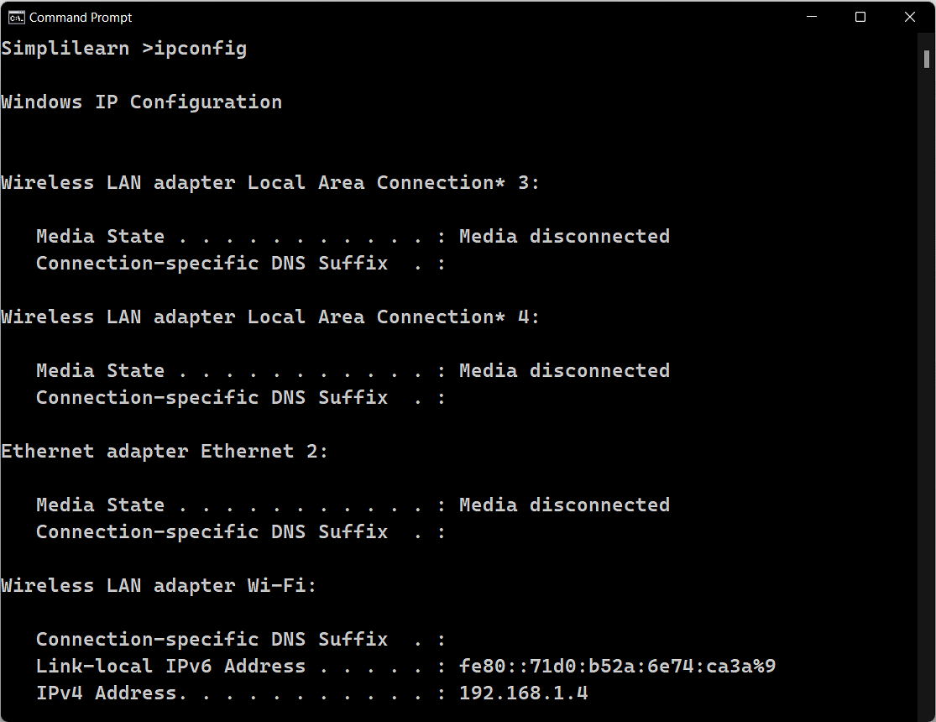
WINDOWS NETWORING COMMAND

Slide 99
IFCONFIG
Ifconfig is an abbreviation for interface configurator in Linux. It is one of the most fundamental network inspection commands. Ifconfig is used to initialize an interface, assign an IP address to it, and enable or disable it. It is also used to display the network interface and the route.

Slide 100
TRACEROUTE
One of the most useful networking commands in Linux is traceroute. It is used for network troubleshooting. It detects the delay and determines the best path to your destination. It primarily aids in the following ways: It names and identifies all of the devices on the path. It takes the path to the destination. It determines and reports the source of network latency.

Slide 101
TRACEPATH
The tracepath command in Linux is similar to the traceroute command. It is employed in the detection of network delays. It does not, however, necessitate root access. It is installed by default in Ubuntu. It follows the path to the specified destination and identifies each hop along the way. If your network is weak, it detects the point at which the network is weak.

Slide 102
PING
Ping is a popular network troubleshooting command in Linux. It essentially tests network connectivity between two nodes. Ping is an abbreviation for Packet Internet Groper. To test network connectivity, the ping command sends an ICMP echo request. It will continue to execute until it is interrupted.

Slide 103
NETSTAT
The Linux netstat command displays network statistics. It provides statistical data about various interfaces, such as open sockets, routing tables, and connection information.

Slide 104
NSLOOKUP
The Linux nslookup command is also used for DNS queries. It is the previous version of dig.

Slide 105
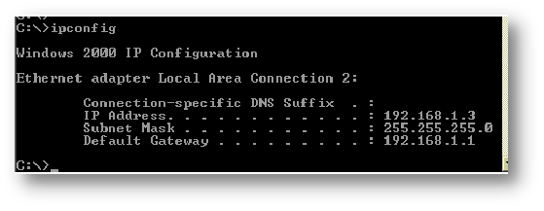
IPCONFIG
It takes the use of yet another necessary and frequently used tool to find network information about your local system, such as IP addresses, DNS addresses, and other information. Default Gateway and Finding Your IP Address are Basic Uses The ipconfig command should be entered at the prompt. The subsequent data is displayed.

Slide 106
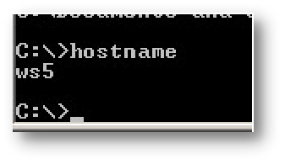
HOSTNAME
a fairly straightforward command that shows your machine's host name. Compared to visiting the control panel > system, this is significantly faster.

Slide 107
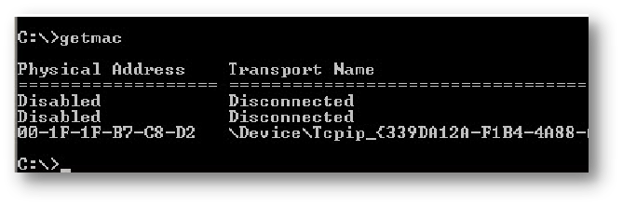
GETMAC
An additional, extremely straightforward command that displays the MAC addresses of your network interfaces

Slide 108
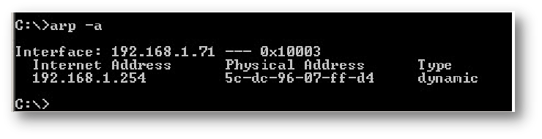
ARP
The address resolution cache can be seen with this.
The most frequent command line switch to use with this command is arp -a.

Slide 109
TASKKILL
See this tutorial for information on how to use the tasklist command to view a list of active tasks and the taskKill command to terminate them by name or processor ID.

Slide 110
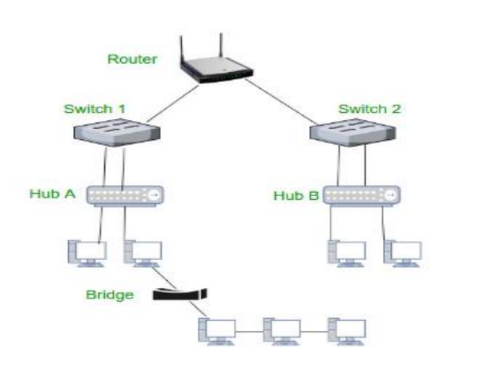
NETWORK
CONNECTING DEVICES

Slide 111
NIC NETWORK INTERFACE CARD
The component that connected your computer to a network is a network interface card. In the figure, the display is a NIC. Each mainframe and server connected to it has the cards configured in a development slot.

Slide 112
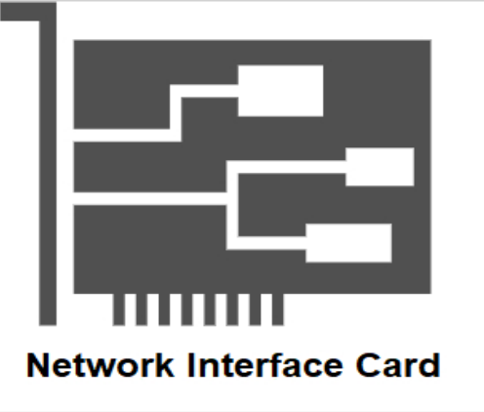

Slide 113
TC TRANSCEIVERS
A computer is connected to a network cable by a device called a transceiver (transmitter/receiver).Network Interface Cards (NICs) are created using transceivers. To send, receive, and detect collisions, a transceiver is required. As shown in the image, the transceiver is connected to the station by a transceiver cable that enables detach pathways for sending and receiving.

Slide 114
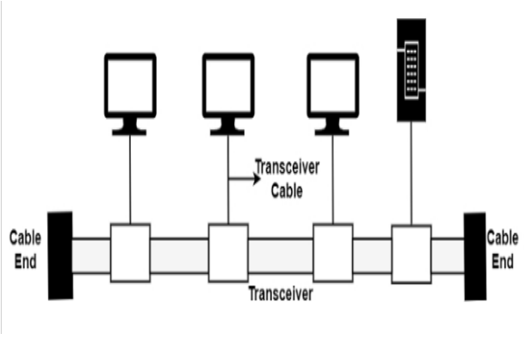

Slide 115
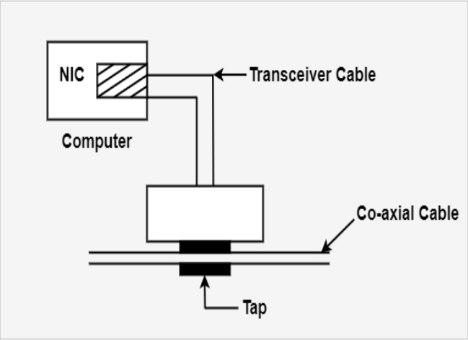
TC TRANSCEIVERS
An external or internal transceiver is possible. Next to the media is a setup for an external transceiver. On the network interface card of the station, an internal transceiver is configured (NIC). In the illustration, the external transceiver is shown.

Slide 116
MC MEDIA CONVERTERS
A device that can connect two distinct networking media is known as a media converter. For instance, the media converter can control the connection between a shielded cable and twisted pair, as shown in the image.

Slide 117
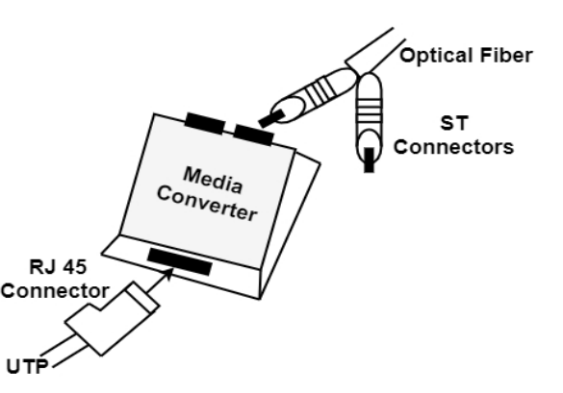

Slide 118
SWITCHES
A switch is a device that offers dedicated connections between two points and bridge services. They connect networks or devices, filter, forward, and flood frames based on the MAC terminal station of each frame. At the data link layer of the OSI model, a switch operates. Technically speaking, they are bridges. They modify data without argument. An assortment of shared/dedicated 10/100/1000 Mbps connections are supported by Ethernet switches.

Slide 119
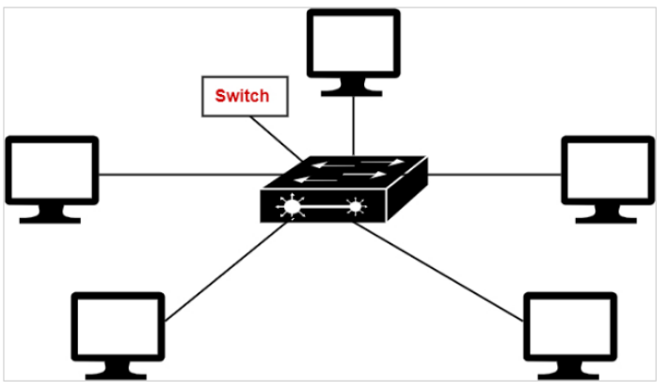

Slide 120
09
WHAT IS A COMPUTER HARDWARE NETWORK?
MY DEAR GREAT TEACHER

Slide 121
COMPUTER HARDWARE
Hardware (abbreviated HW) refers to all physical components of a computer system, including the devices that connect to it. You can't build a computer or use software without hardware. The screen on which you are reading this is also a piece of hardware.

Slide 122
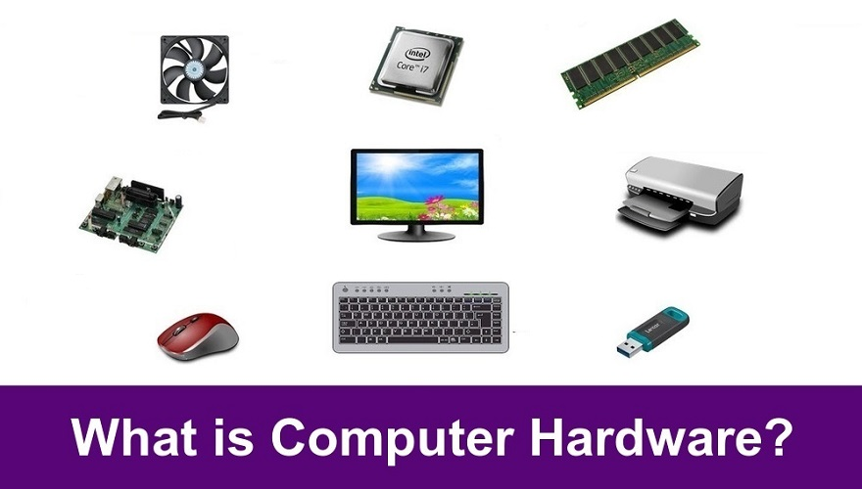
COMPUTERHARDWARE

Slide 123
10
WHAT IS A NETWORK HARDWARE?
MY DEAR GREAT TEACHER

Slide 124
NETWORK HARDWARE
A group of physical or networked devices known as "network hardware" are necessary for interaction and communication among hardware components operating on a computer network. These are specialized hardware elements that link to one another and allow a network to run smoothly and effectively.

Slide 125
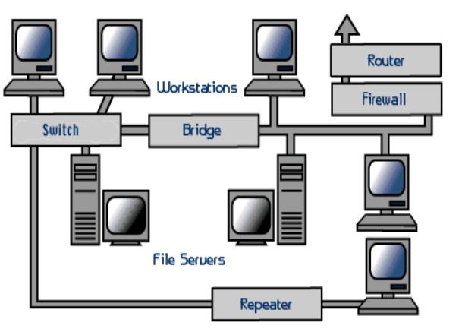

Slide 126
11
WHAT IS A SOFTWARE ?
MY DEAR GREAT TEACHER

Slide 127
2 LIST OF TYPES OF SOFTWARE Generally speaking, software can be divided into two categories: system software and application software.
SYSTEM SOFTWARE
OPERATING
SYSTEM
MY DEAR GREAT TEACHER

Slide 128
SOFTWARE
Software is a collection of instructions, data, or computer programs used to run computers and carry out particular activities. Software instructs a computer on how to run, to put it another way. It's a general term for programs, scripts, and applications that run on computers, cell phones, tablets, and other smart devices. Hardware, or the actual components of a computer that do the work, contrasts with software.

Slide 129
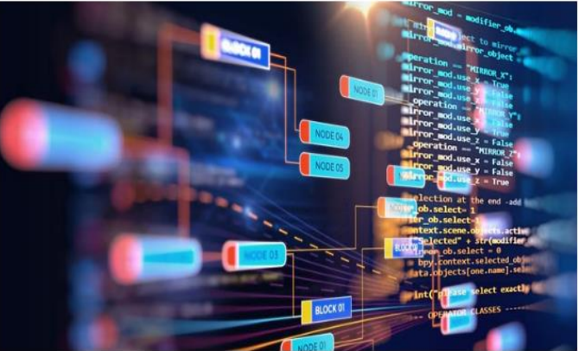

Slide 130
SYSTEM SOFTWARE
When it comes to system software, it makes it easier for the user and the hardware to work together and even communicate. Essentially, it is a piece of software that controls how the hardware of the computer behaves in order to provide the user with the fundamental functionalities they require. System software can be thought of as acting as a middleman between the user and the hardware, or even as a middle layer. These programs authorize a setting or platform that other programs can use with ease. Because of this, system software is crucial to the control of the complete computer system.

Slide 131
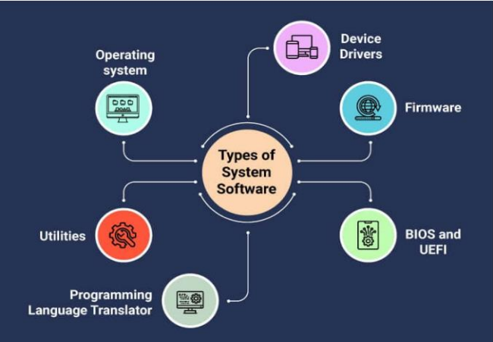

Slide 132
OPERATING SOFTWARE
Being a prominent example for system software, it is essentially a collection of software which handles resources as well as offers general services for various other application which actually run over them. There are different types of operating systems like embedded, real-time, distributed, single-user, multi-user, mobile, internet and much more. Full stack web development services develop apps to operate on a mobile operating system like Android and iOS.

Slide 133
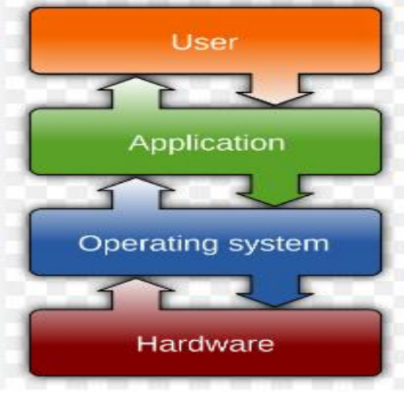

Slide 134
DEVICES DRIVERS
This kind of software regulates specific hardware that is practically connected to the system. Displays, printers, sound cards, hard drives, keyboards, and mice are examples of various hardware devices that need drivers in order to connect to a system quickly.

Slide 135
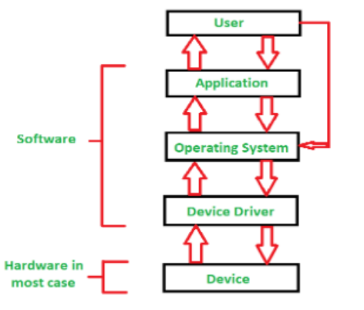

Slide 136
FIRMWARE
It is actually a piece of permanent software that is stored in the read-only memory of the machine. It simply consists of a collection of instructions that are permanently recorded on the hardware. It provides crucial details on how one piece of hardware interacts with other pieces of hardware.

Slide 137
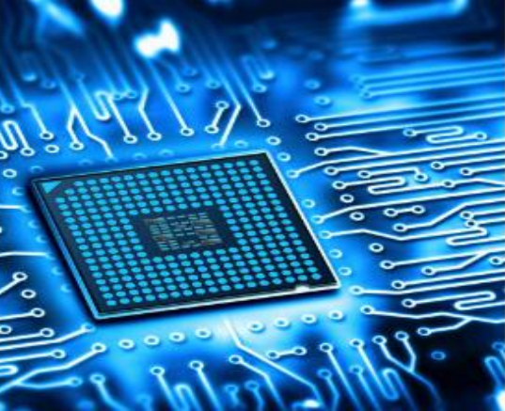

Slide 138
UTILITY
These programs are made to help with analyzing, optimizing, setting, and managing a particular computer system. It supports the technical foundation of computers. software such as defragmenters, antivirus programs, disk management and cleanup tools, compression tools, etc.

Slide 139
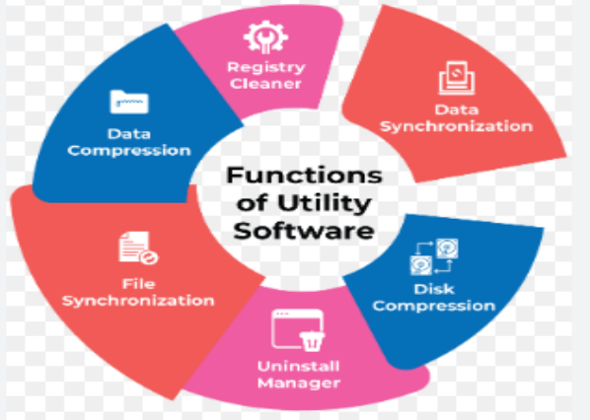

Slide 140
APPLICATION SOFTWARE
They are also sometimes referred to as end-user programs or productivity programs, because they help the user with a variety of tasks like internet research, note-taking, graphic creation, account maintenance, computation, and even playing video games. They effectively sit on top of the operating system. They have particular functions or duties that they are intended to carry out and are used by the end user. These programs are frequently created through custom software development, according to the needs of the users. Software applications come in a range.

Slide 141
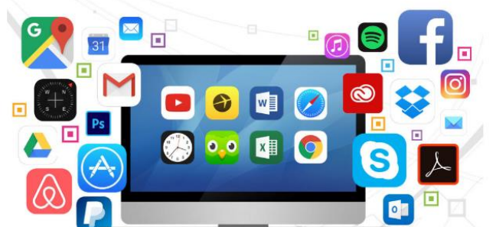

Slide 142
WORD PROCESSORS
These software programs are intended for documentation.
Assists in preserving materials even as well as assisting in formatting

Slide 143
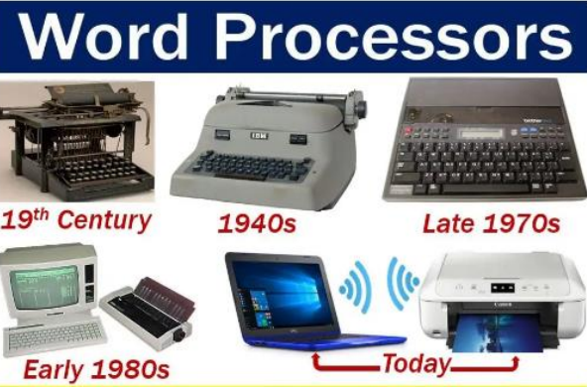

Slide 144
DATA BASE SOFTWARE
It is sometimes referred to as a database management system, or simply DBMS, and is used to create and maintain databases.Such software facilitates the arrangement of data.

Slide 145


Slide 146
MULTIMEDIA SOFTWARE
This software offers the ability to play, create, and record audio, video, and image files. Animation, graphic design, and image and video editing are all possible with these apps. Because there is such a great need for these programs, every software product development company has a wide range of possibilities for developing them.

Slide 147


Slide 148
WEB BROWSERS
The internet can be browsed with this software. Web browsers let people locate and successfully retrieve material on the internet..

Slide 149


Slide 150
FREE WARE
These programs are provided without charge. They can be quickly downloaded from the internet and used without incurring any costs or taxes. They do not, however, grant any kind of freedom to completely alter the software or impose a certain cost for its dissemination. To reach more clients, the best software development company can create its own shareware.

Slide 151


Slide 152
SHARE WARE
This software is distributed freely to users on a fixed trial basis. It generally comes with a set time limit, and on the expiration of the time limit, the user is finally asked to pay a fixed fee for the continued services. There are different types of shareware such as Freemium, Donationware, Adware, Demoware etc.

Slide 153


Slide 154
OPEN SOURCE
Such types of software are usually available to users along with their source code which means that the user can easily modify and distribute the software as well as add additional features to them. They can either be chargeable or free.

Slide 155


Slide 156
CONCLUSION
Given the growing importance of software in peoples' daily lives, full stack web development services are now providing the most up-to-date software to meet demand. As we all know, there are different kinds of software. While the market for system software is already crowded with major players like Microsoft, Apple, and others, there is fierce competition in the market for application software, with both established and emerging players vying for a competitive edge.
The definition of a software and its various types are mentioned above. Any of these software can be developed by a software development company in order to make significant profits.

Slide 157

HOW TO FIND OUT YOUR COMPUTERS NAME
Open a terminal window and type the following command.
You may find out your computer's name using this command.
The name of the computer appears in the first section, and the name of the domain appears in the second.

Slide 158

Run the following command to get only the computer name:

Slide 159

This will give you the local host. If you want to find out which domain system is running, use this command.

Slide 160

Retrieve the IP address for the hostname by using the following command.

Slide 161

The aliases for the computer can be found out by using this command given below.

